Slide 1
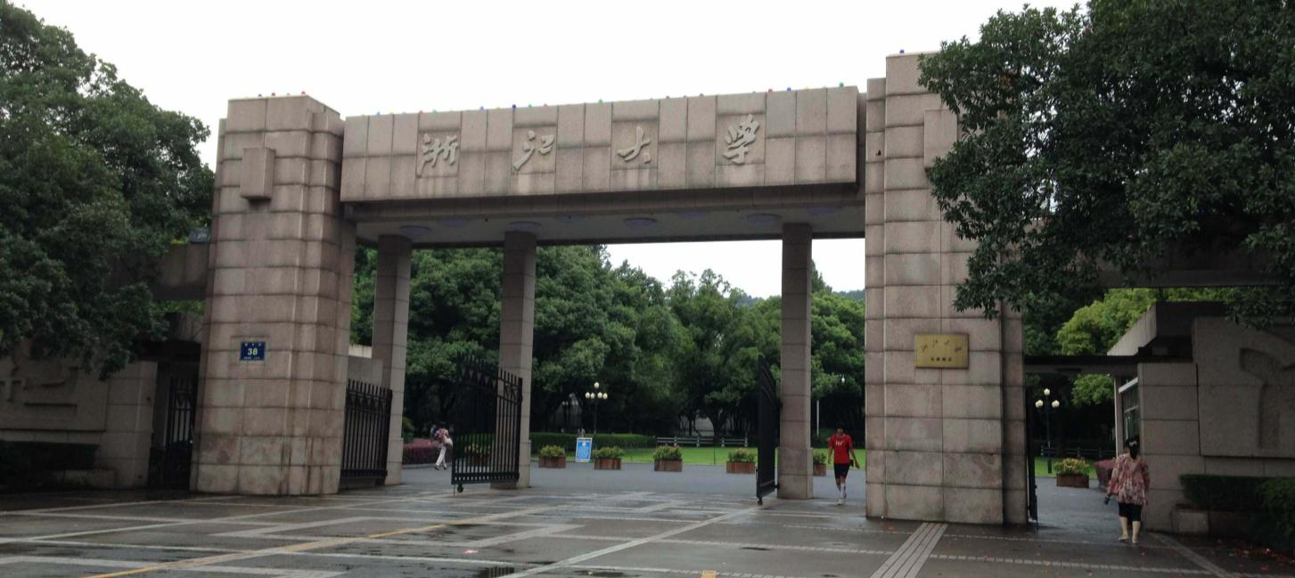
Common hormones and their functions

Slide 2
Epinephrine
[ˌepə'nefrɪn] 肾上腺素
function：
increase heart rate, blood pressure, and glucose levels in the blood, preparing the body for a "fight or flight" response
improve oxygen delivery to the muscles, so that you can gain a better physical performance during stressful situations

Slide 3
insulin
[ˈɪnsəlɪn] 胰岛素
function：
balance blood sugar levels
stimulates the absorption of glucose by cells
inhibits the breakdown and release of glucose, preventing excessive blood sugar levels

Slide 4
growth hormone
[ɡroʊθ ˈhɔrˌmoʊn] 生长激素
function：
engaged in the growth and development of bones and muscles
stimulates the production of ILGF-I, which promotes cell division and differentiation
stimulates the breakdown of fats, increasing the availability of energy for the body

Slide 5
Thank you for listenning！

